Slide 1
Machine Learning

Slide 2
Machine Learning
Definition: Creating and using models that are learned from data.
Also called as predictive modeling or data mining.
Goal
  Use existing data to develop models
  Predict output for new data.
Different kinds of models
  Supervised models (trained on labeled data)
  Unsupervised models (no labeled data)
  Semi-supervised (only some of the data are labeled)
  Online (Model needs to continuously adjust to new arriving data)

Slide 3
Selection of Models
There is an entire universe of models.
We have to select a parametrized family of models and then use the data to learn parameters .
Example
  We might assume that a person’s height is roughly a linear function of his weight, and then use data to train that linear function.
  We might assume that a decision tree is a good way to diagnose what diseases our patients have, and then use data to learn the optimal tree.

Slide 4
Overfitting and Underfitting
After we have selected a model, and we have started training, the common danger in machine learning is overfitting.
  Model that performs well on the data you train, but generalizes poorly on new data.
  Model learns Noise in the data.
Another danger is underfitting, producing a model that doesn’t perform well on the training data
  When this happens, we typically decide that the model isn’t good, and we keep on looking for a better model.

Slide 5
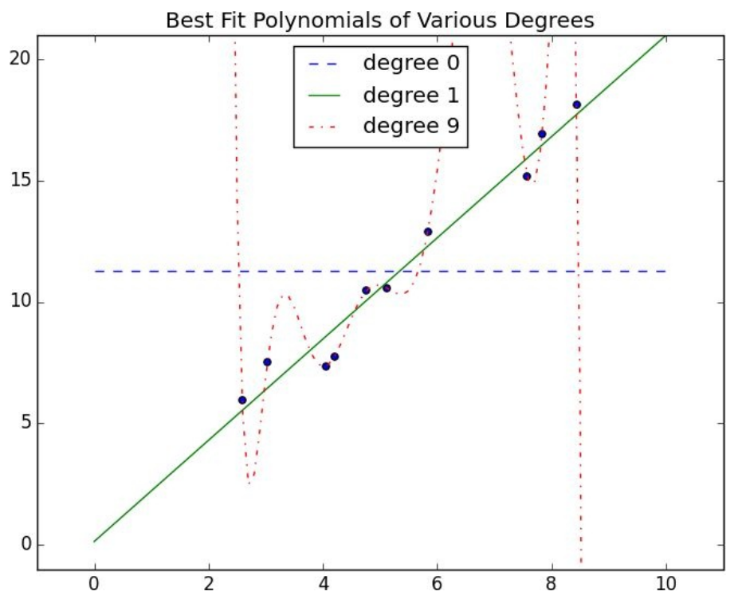
Overfitting and Underfitting
The blue line is underfit, as the actual data is not trained.
The dotted red line is overfit, it works fine for current data, but will most likely miss if we were to pick more data points.
Green line strikes a nice balance. It will likely close to new data points.
Models that are too complex leads to overfitting, and they don’t generalize well.
How to ensure that our model is not too complex?

Slide 6
Overfitting and Underfitting
Test the model on unseen data.
Solution-1:
  Split data 2/3 data is used for training, measure performance on 1/3 data
  If the model was overfit to the training data, then it will hopefully perform really poorly on the (completely separate) test data.
Problem-1 (Common pattern in Test and train data):
  There are common patterns in the test and train data that wouldn’t generalize to a larger data set.
  For example your data contains activity of one user per row. The model learns about the user. If the same user is in the test data also, it might predict well for the same user. But might fail to predict for a new user.

Slide 7
Overfitting and Underfitting
Problem-2 (How to select the model):
  Train/Test partition judges the performance of a model.
  How to decide which model to pick?
  The model that performs best on the test data will work fine the test data..
  The test data acts as a second training set here.
Solution-2
  Split data into three parts (Train – Validate - Test)
    Train : For building models
    Validate : Choosing among trained models
    Test : Judging the final model.

Slide 8
Correctness
Problem-2 (How to select the model):
  Train/Test partition judges the performance of a model.
  How to decide which model to pick?
  The model that performs best on the test data will work fine the test data..
  The test data acts as a second training set here.
Solution-2
  Split data into three parts (Train – Validate - Test)
    Train : For building models
    Validate : Choosing among trained models
    Test : Judging the final model.

Slide 9
Bias vs Variance (For Overfitting/Underfitting)
What would happen if you were to retrain your model many times on different data sets?
Degree 0 model will make lots of mistakes
  It means it has high bias.
Degree 0 model trained on different data sets should have pretty much same average results
  It means it has low variance.
Degree 9 model
  Low bias
  High variance (training two different models on different datasets will be lot of different)

Slide 10
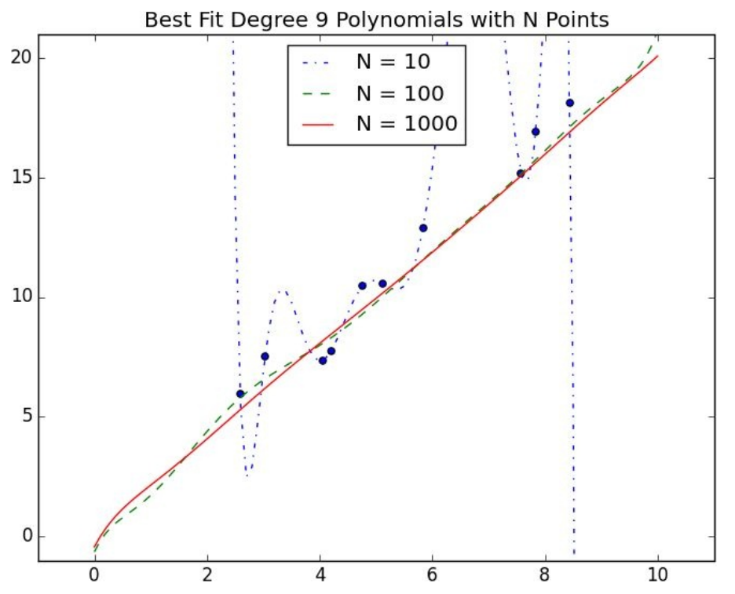
Bias vs Variance (For Overfitting/Underfitting)
If model has high bias
  Try to add more features
If model has high variance
  Try to remove features
  Obtain more data if you can
  Figure shows the degree 9 model training on N data sets (10, 100, 1000)
  N=1000 is almost equal to degree 1 model.
Holding model complexity as constant, the more data you have, the harder it is to overfit.
More data will not help with bias, as the model doesn’t use more features.

Slide 11
Feature extraction and selection
Features
  Are the inputs fed to the model. They determine how the model learns.
Too few features
  Can cause underfitting
Too many features
  Can cause overfitting
In some cases the features are obvious
  Years of experience as a feature is good to predict salary.
Spam email
  Require more detailed features to determine if it is spam or not.

Slide 12
Feature extraction and selection
We will extract features from our data. Feature fall into three categories
  Naive classifer is suited for Yes, No features.
  Regression models are suited for numerical features
  Decision trees can deal with numeric or category features.
Feature selection can involve removing unnecessary features using techniques such as
  Demiensionality reduction
  Regularization
Good feature selection requires domain knowledge and experiementation

